Slide 1
CS2040S Tutorial 5

Slide 2
Tutorial Time
Slides for tutorials are taken and adapted from Christian

Slide 3
Problem 1: AVL vs Trie
Discuss the trade-offs of using AVL and trie to store strings.

Slide 4
Problem 1: AVL vs Trie
Discuss the trade-offs of using AVL and trie to store strings.
Trade-off: time complexity, space complexity

Slide 5
Problem 1: AVL vs Trie
Discuss the trade-offs of using AVL and trie to store strings.
Time complexity for insert, delete, and find a word with length L to a collection of N words:

Slide 6
Problem 1: AVL vs Trie
Discuss the trade-offs of using AVL and trie to store strings.
Time complexity for insert, delete, and find a word with length L to a collection of N words:
AVL Tree: O(L log N)
Trie: O(L)

Slide 7
Problem 1: AVL vs Trie
Discuss the trade-offs of using AVL and trie to store strings.
Time complexity for insert, delete, and find a word with length L to a collection of N words:
AVL Tree: O(L log N)
Trie: O(L)
Space complexity:

Slide 8
Problem 1: AVL vs Trie
Discuss the trade-offs of using AVL and trie to store strings.
Time complexity for insert, delete, and find a word with length L to a collection of N words:
AVL Tree: O(L log N)
Trie: O(L)
Space complexity:
AVL Tree: O(total_string_length)
Trie: O(total_string_length)
Trie tends to have more overhead cost (more nodes and edges)

Slide 9
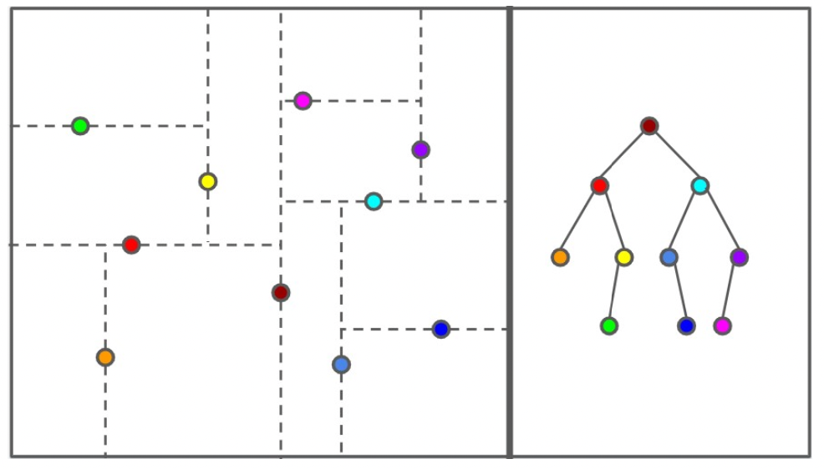
Problem 2: kd-Trees

Slide 10
Problem 2a: kd-Trees
How do you search for a point in a kd-tree? What is the running time?

Slide 11
Credits to Matthew for this slide
x
y
x
y

Slide 12
Credits to Matthew for this slide
x
y
x
y
I want to search this little guy

Slide 13

Credits to Matthew for this slide
x
y
x
y
search
We are in the x-splitting plane
I want to search this little guy

Slide 14
Credits to Matthew for this slide
x
y
x
y
search
Go to the right subtree!
I want to search this little guy

Slide 15
Credits to Matthew for this slide
x
y
x
y
search
Currently in the y-splitting plane. Up = right subtree, Down = left subtree
I want to search this little guy

Slide 16
Credits to Matthew for this slide
x
y
x
y
search
Go to the left subtree!
I want to search this little guy

Slide 17
Credits to Matthew for this slide
x
y
x
y
search
Got the little guy!

Slide 18
Problem 2a: kd-Trees
What is the running time?

Slide 19
Problem 2a: kd-Trees
What is the running time?
O(h), height of the tree
Note: kd-tree is not necessarily balanced. That’s the goal of 2b!

Slide 20
Problem 2b: kd-Trees
You are given an (unordered) array of points. What would be a good way to build a kd-tree? Think about what would keep the tree nicely balanced. What is the running time of the construction algorithm?

Slide 21
Problem 2b: kd-Trees
You are given an (unordered) array of points. What would be a good way to build a kd-tree? Think about what would keep the tree nicely balanced. What is the running time of the construction algorithm?
Find median element in x as root for the first level. Then build left tree and right tree
Find median element in y as root for the second level. Then build left tree and right tree.

Slide 22
Problem 2b: kd-Trees
You are given an (unordered) array of points. What would be a good way to build a kd-tree? Think about what would keep the tree nicely balanced. What is the running time of the construction algorithm?
Find median element in x as root for the first level. Then build left tree and right tree
Find median element in y as root for the second level. Then build left tree and right tree.
How fast can we find median? What are our options?

Slide 23
Credits to Matthew for this slide

Slide 24
Credits to Matthew for this slide
Root Node

Slide 25
Credits to Matthew for this slide
Convention:
Left child node = smaller x (or y depending on the splitting plane) coordinate
Each level of the tree alternates between X and Y coordinates to split the remaining points

Slide 26
Credits to Matthew for this slide

Slide 27
Credits to Matthew for this slide
X Splitting Plane
Y Splitting Plane
X Splitting Plane
Alternating Plane splitting scheme

Slide 28
Credits to Matthew for this slide

Slide 29
Credits to Matthew for this slide

Slide 30
Credits to Matthew for this slide

Slide 31
Credits to Matthew for this slide

Slide 32
Credits to Matthew for this slide

Slide 33
Credits to Matthew for this slide

Slide 34
Credits to Matthew for this slide

Slide 35
Problem 2b: kd-Trees
What is the running time of the construction algorithm?
Find median element in x as root for the first level. Then build left tree and right tree
Find median element in y as root for the second level. Then build left tree and right tree.
How can we find the median at each level? How fast can we do?

Slide 36
Problem 2b: kd-Trees
How can we find the median at each level? How fast can we do?
Option 1: Sort at every level
Runtime recurrence: T(n) = 2T(n/2) + O(n log n)
Runtime: O(n log²n)

Slide 37
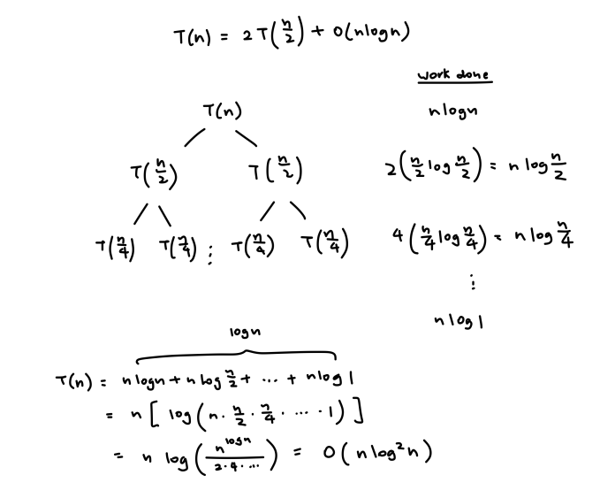

Slide 38
Problem 2b: kd-Trees
How can we find the median at each level? How fast can we do?
Option 1: Sort at every level
Runtime recurrence: T(n) = 2T(n/2) + O(n log n)
Runtime: O(n log²n)
Option 2: Quickselect
Runtime recurrence: T(n) = 2T(n/2) + O(n)
Runtime: O(n log n)

Slide 39
Problem 2c: kd-Trees
How would you find the element with the minimum (or maximum) x-coordinate in a kd-tree? How expensive can it be, if the tree is perfectly balanced?

Slide 40
Problem 2c: Min/Max x-coordinate in kd-Tree
Credits to Matthew for this slide
x
y
x
y

Slide 41
Credits to Matthew for this slide
I want to get this little guy
x
y
x
y
findMinX
We want to find the node with smallest x-coordinate

Slide 42
Credits to Matthew for this slide
I want to get this little guy
x
y
x
y
findMinX
This is an x-splitting plane. What should we do?

Slide 43
Credits to Matthew for this slide
I want to get this little guy
x
y
x
y
findMinX
Go left!

Slide 44
Credits to Matthew for this slide
I want to get this little guy
x
y
x
y
findMinX
We are now in the y-splitting plane. wat do

Slide 45
Credits to Matthew for this slide
I want to get this little guy
x
y
x
y
findMinX
No choice but to go to both trees! No info about x-coord

Slide 46
Problem 2c: kd-Trees
What’s the recurrence relation?

Slide 47
Problem 2c: kd-Trees
What’s the recurrence relation?
T(n) = 2T(n / 4) + O(1)
n / 4 because we explore the subtree 2 levels down.
2T(n / 4) because during the y-split, we have to explore both trees.

Slide 48
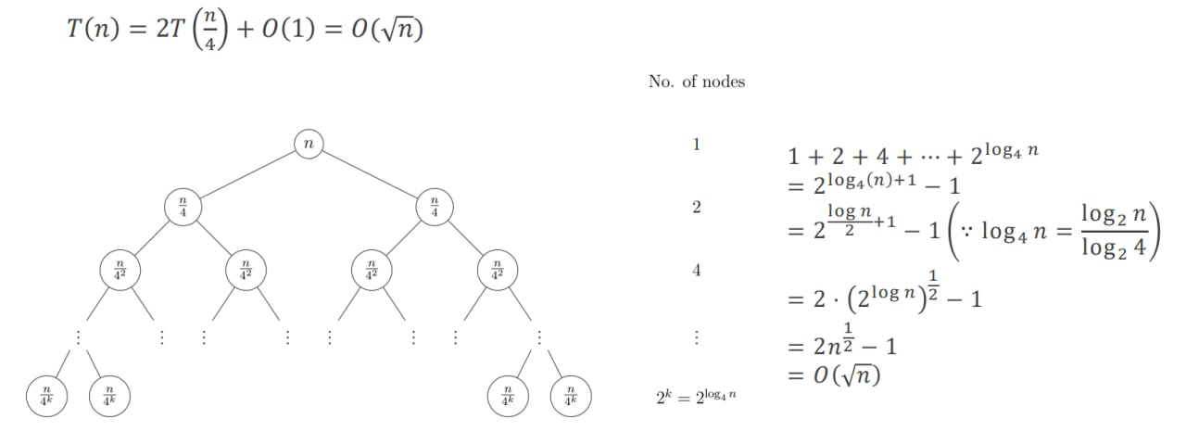

Slide 49
Problem 2c: kd-Trees
What’s the recurrence relation?
T(n) = 2T(n / 4) + O(1)
n / 4 because we explore the subtree 2 levels down.
2T(n / 4) because during the y-split, we have to explore both trees.
Runtime: O(√n)

Slide 50
Problem 3: Tries
Coming up with a good name for your baby is hard. Imagine you want to build a data structure to help answer these types of questions. Your data structure should support the following operations:
insert(name, gender, count): adds a name of a given gender, with a count of how many babies have that name.
countName(name, gender): returns the number of babies with that name and gender.
countPrefix(prefix, gender): returns the number of babies with that prefix of their name and gender.
countBetween(begin, end, gender): returns the number of babies with names that are lexicographically after begin and before end that have the proper gender.

Slide 51
Want to store:
"aaaa" (2)
"aaab" (3)
"aaac" (1)
"aaba" (5)
"aab" (7)
"baa" (6)
"bab" (3)
start
a
b
a
a
a
b
a
b
Augment
What would be a useful augmentation? Maybe we start with the one at the leaves
a
b
c
a

Slide 52
Want to store:
"aaaa" (2)
"aaab" (3)
"aaac" (1)
"aaba" (5)
"aab" (7)
"baa" (6)
"bab" (3)
start
a
b
a
a
a
b
a
b
countName
Now when you search “aaaa”, “aaab”, “aaac”, you will get the exact count!
a
b
c
a
n = 2
n = 3
n = 1

Slide 53
Want to store:
"aaaa" (2)
"aaab" (3)
"aaac" (1)
"aaba" (5)
"aab" (7)
"baa" (6)
"bab" (3)
start
a
b
a
a
a
b
a
b
countPrefix(“aaa”)
How many names have the prefix aaa?
a
b
c
a
n = 2
n = 3
n = 1

Slide 54
Want to store:
"aaaa" (2)
"aaab" (3)
"aaac" (1)
"aaba" (5)
"aab" (7)
"baa" (6)
"bab" (3)
start
a
b
a
a
n = 6
a
b
a
b
countPrefix(“aaa”)
2 + 3 + 1 = 6 :D
It’s the total of the children’s counts!
a
b
c
a
n = 2
n = 3
n = 1

Slide 55
Want to store:
"aaaa" (2)
"aaab" (3)
"aaac" (1)
"aaba" (5)
"aab" (7)
"baa" (6)
"bab" (3)
start
a
b
n = 18
n = 9
a
a
n = 18
n = 9
n = 6
a
b
a
b
n=12
n = 6
n = 3
Augment
So every node stores the count of names under that node!
a
b
c
a
n = 2
n = 3
n = 1
n = 5

Slide 56
Want to store:
"aaaa" (2)
"aaab" (3)
"aaac" (1)
"aaba" (5)
"aab" (7)
"baa" (6)
"bab" (3)
start
a
b
n = 18
n = 9
a
a
n = 18
n = 9
n = 6
a
b
a
b
n=12
n = 6
n = 3
Augment
How to tell if a string is a name or prefix?
a
b
c
a
n = 2
n = 3
n = 1
n = 5

Slide 57
Want to store:
"aaaa" (2)
"aaab" (3)
"aaac" (1)
"aaba" (5)
"aab" (7)
"baa" (6)
"bab" (3)
start
a
b
n = 18
n = 9
a
a
n = 18
n = 9
n = 6
a
b
a
b
n=12
word
word
n = 6
n = 3
word
Augment
How to tell if a string is a name or prefix?
Set word flag!
a
b
c
a
n = 2
n = 3
n = 1
n = 5
word
word
word
word

Slide 58
Want to store:
"aaaa" (2)
"aaab" (3)
"aaac" (1)
"aaba" (5)
"aab" (7)
"baa" (6)
"bab" (3)
start
a
b
n = 18
n = 9
a
a
n = 18
n = 9
n = 6
a
b
a
b
n=12
word
word
n = 6
n = 3
word
countName(“aab”)
12 - 5 = 7 Subtract away total count of child nodes!
a
b
c
a
n = 2
n = 3
n = 1
n = 5
word
word
word
word

Slide 59
Want to store:
"aaaa" (2)
"aaab" (3)
"aaac" (1)
"aaba" (5)
"aab" (7)
"baa" (6)
"bab" (3)
start
a
b
n = 18
n = 9
a
a
n = 18
n = 9
n = 6
a
b
a
b
n=12
n = 6
n = 3
insert(“bac”, 2)
What should happen?
a
b
c
a
n = 2
n = 3
n = 1
n = 5

Slide 60
Want to store:
"aaaa" (2)
"aaab" (3)
"aaac" (1)
"aaba" (5)
"aab" (7)
"baa" (6)
"bab" (3)
"bac" (2)
start
a
b
n = 18
n = 9
a
a
n = 18
n = 9
n = 6
a
b
a
b
c
n=12
n = 6
n = 3
n = 2
insert(“bac”, 2)
Inserted here! Is that all?
a
b
c
a
n = 2
n = 3
n = 1
n = 5

Slide 61
Want to store:
"aaaa" (2)
"aaab" (3)
"aaac" (1)
"aaba" (5)
"aab" (7)
"baa" (6)
"bab" (3)
"bac" (2)
start
a
b
n = 18
n = 11
a
a
n = 18
n = 11
n = 6
a
b
a
b
c
n=12
n = 6
n = 3
n = 2
insert(“bac”, 2)
Should have +2 along the way!
a
b
c
a
n = 2
n = 3
n = 1
n = 5

Slide 62
Intermezzo: Suppose given this AVL tree. How can you efficiently count the number of nodes between 13 and 377 (both exclusive)?
34
5
233
13
89
610
8
21
55
377
987
Rank:
1
2
3
4
5
6
7
8
9
10
11

Slide 63
Intermezzo: Suppose given this AVL tree. How can you efficiently count the number of nodes between 13 and 377 (both exclusive)?
34
Take ranks!
rank(377) covers 9 elements
5
233
13
89
610
8
21
55
377
987
Rank:
1
2
3
4
5
6
7
8
9
10
11

Slide 64
Intermezzo: Suppose given this AVL tree. How can you efficiently count the number of nodes between 13 and 377 (both exclusive)?
34
Take ranks!
rank(377) covers 9 elements
rank(13) covers 3 elements
5
233
13
89
610
8
21
55
377
987
Rank:
1
2
3
4
5
6
7
8
9
10
11

Slide 65
Intermezzo: Suppose given this AVL tree. How can you efficiently count the number of nodes between 13 and 377 (both exclusive)?
34
Take ranks!
rank(377) covers 9 elements
rank(13) covers 3 elements
Ans:
rank(377) - rank(13) - 1
5
233
13
89
610
8
21
55
377
987
Rank:
1
2
3
4
5
6
7
8
9
10
11

Slide 66
Want to store:
"aaaa" (2)
"aaab" (3)
"aaac" (1)
"aaba" (5)
"aab" (7)
"baa" (6)
"bab" (3)
"bac" (2)
start
a
b
n = 18
n = 11
a
a
n = 18
n = 11
n = 6
a
b
a
b
c
n=12
n = 6
n = 3
n = 2
countBetween
Use the same idea here!
a
b
c
a
n = 2
n = 3
n = 1
n = 5

Slide 67
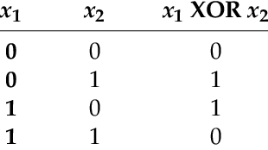
Problem 4: Bit Tries
Given an array of 32 bits unsigned positive integers, find 2 numbers such that their XOR is maximum.
XOR TABLE

Slide 68
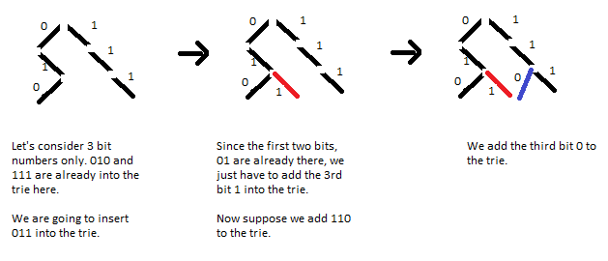
Problem 4: Bit Tries
Bit tries – where each node is either a 0 or a 1, representing the i-th bit’s value where i = depth, counting from the MSB
Adding an integer:

Slide 69
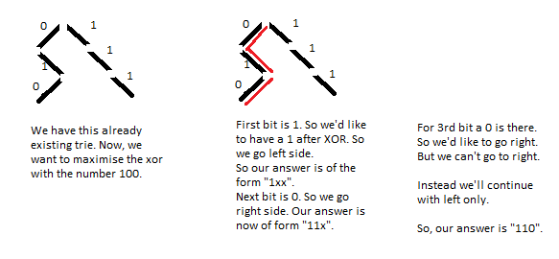
Problem 4: Bit Tries
To find the largest value of an XOR operation, the value of XOR should have every bit to be a set bit i.e 1. In a 32-bit number, the goal is to get the most 1 set starting left to right.
Example with 3 bits.

Slide 70
SORTING JUMBLE (CS2040S 2020 MIDTERM)
Section by Ian Yong

Slide 71
Sorting Jumble
The first column in the table below contains an unsorted list of words. The last column contains a sorted list of words. Each intermediate column contains a partially sorted list.
Each intermediate column was constructed by beginning with the unsorted list at the left and running one of the sorting algorithms that we learned about in class, stopping at some point before it finishes. Each algorithm is executed exactly as described in the lecture notes. One column has been sorted using a sorting algorithm that you have not seen in class. (Recursive algorithms recurse on the left half of the array before the right half.)
Identify which column was (partially) sorted with which sorting algorithm.

Slide 72
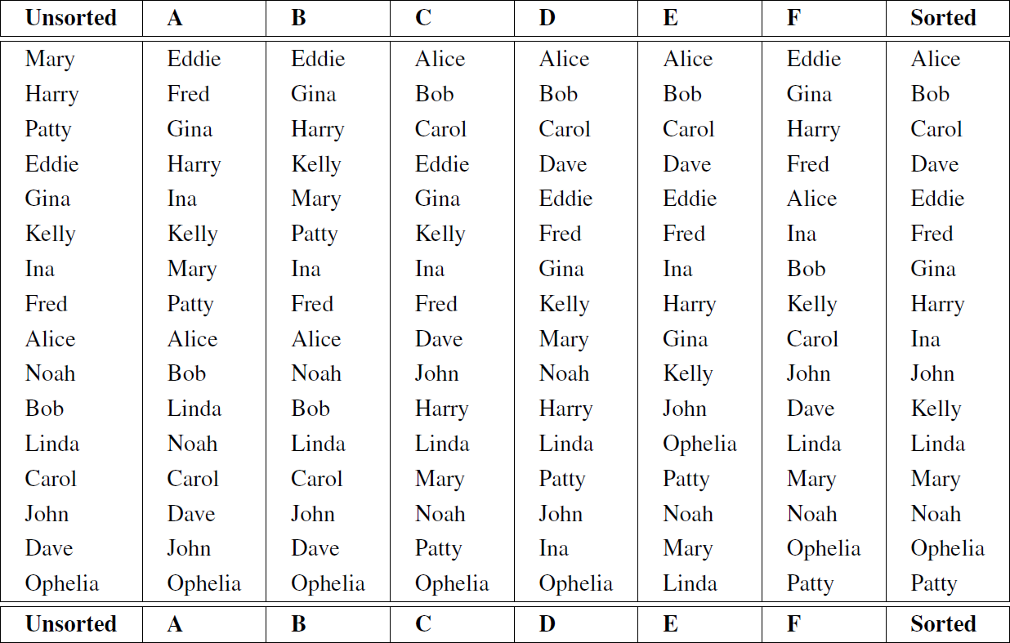
Bubble
Selection
Insertion
Merge
Quick(first ele pivot)
None

Slide 73
Sorting Jumble
Do not just execute each sorting algorithm, step-by-step, until it matches one of the columns
You will run out of time if you do that
Only do so if you’ve already narrowed down to a few possible search algorithms and you cannot make use of any other invariants
Think in terms of invariants that are true at every step of the algorithm!

Slide 74
Sorting Algorithm | Description | Invariant | Is stable?
Bubble Sort | “Bubble” the largest element to the end of the array through repeated swapping of out-of-order adjacent pairs (inversions) |  | Yes
Selection Sort | Select the minimum element and add it to the sorted region of the array by swapping. Repeat until all elements have been selected. |  | No
Insertion Sort | Select the first element in the unsorted region of the array and find where to place it in the sorted region. Repeat until all elements have been selected. |  | Yes
Merge Sort | Halve the array, recursively sort, then merge | Each subarray is already sorted when merging | Yes
Quick Sort (with first element pivot) | Partition around the first element, then repeat on subarrays | All elements to the left/right of the pivot are smaller/larger | No

Slide 75
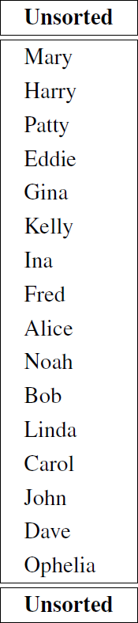
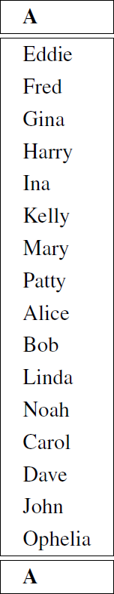
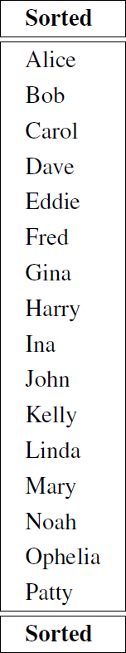
Sorting Algorithm | Invariant
Bubble Sort
Selection Sort
Insertion Sort
Merge Sort | Each subarray is already sorted when merging
Quick Sort (with first element pivot) | All elements to the left/right of the pivot are smaller/larger

Slide 76
Sorting Algorithm | Invariant
Bubble Sort
Selection Sort
Insertion Sort
Merge Sort | Each subarray is already sorted when merging
Quick Sort (with first element pivot) | All elements to the left/right of the pivot are smaller/larger

Slide 77
Sorting Algorithm | Invariant
Bubble Sort
Selection Sort
Insertion Sort
Merge Sort | Each subarray is already sorted when merging
Quick Sort (with first element pivot) | All elements to the left/right of the pivot are smaller/larger
Since the ordering of elements in array A is different from the unsorted array, we know that at least one iteration of the sort was run. However, the largest element (Patty) is not at the end of the array. Thus, sorting algorithm A is not Bubble Sort.

Slide 78
Sorting Algorithm | Invariant
Bubble Sort
Selection Sort
Insertion Sort
Merge Sort | Each subarray is already sorted when merging
Quick Sort (with first element pivot) | All elements to the left/right of the pivot are smaller/larger

Slide 79
Sorting Algorithm | Invariant
Bubble Sort
Selection Sort
Insertion Sort
Merge Sort | Each subarray is already sorted when merging
Quick Sort (with first element pivot) | All elements to the left/right of the pivot are smaller/larger
Since the ordering of elements in array A is different from the unsorted array, we know that at least one iteration of the sort was run. However, the smallest element (Alice) is not at the start of the array. Thus, sorting algorithm A is not Selection Sort.

Slide 80
Sorting Algorithm | Invariant
Bubble Sort
Selection Sort
Insertion Sort
Merge Sort | Each subarray is already sorted when merging
Quick Sort (with first element pivot) | All elements to the left/right of the pivot are smaller/larger

Slide 81
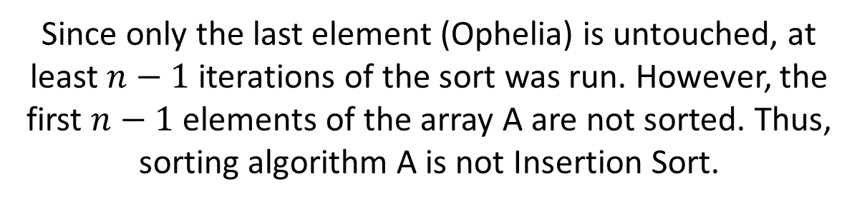
Sorting Algorithm | Invariant
Bubble Sort
Selection Sort
Insertion Sort
Merge Sort | Each subarray is already sorted when merging
Quick Sort (with first element pivot) | All elements to the left/right of the pivot are smaller/larger

Slide 82
Sorting Algorithm | Invariant
Bubble Sort
Selection Sort
Insertion Sort
Merge Sort | Each subarray is already sorted when merging
Quick Sort (with first element pivot) | All elements to the left/right of the pivot are smaller/larger

Slide 83
Sorting Algorithm | Invariant
Bubble Sort
Selection Sort
Insertion Sort
Merge Sort | Each subarray is already sorted when merging
Quick Sort (with first element pivot) | All elements to the left/right of the pivot are smaller/larger
Since each subarray (when split by powers of 2) is locally sorted, sorting algorithm A is Merge Sort!

Slide 84
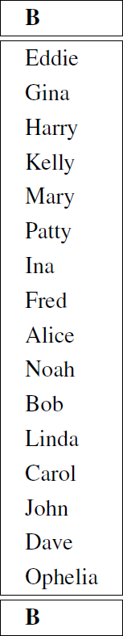
Sorting Algorithm | Invariant
Bubble Sort
Selection Sort
Insertion Sort
Quick Sort (with first element pivot) | All elements to the left/right of the pivot are smaller/larger

Slide 85
Sorting Algorithm | Invariant
Bubble Sort
Selection Sort
Insertion Sort
Quick Sort (with first element pivot) | All elements to the left/right of the pivot are smaller/larger

Slide 86
Sorting Algorithm | Invariant
Bubble Sort
Selection Sort
Insertion Sort
Quick Sort (with first element pivot) | All elements to the left/right of the pivot are smaller/larger
Since the ordering of elements in array B is different from the unsorted array, we know that at least one iteration of the sort was run. However, the largest element (Patty) is not at the end of the array. Thus, sorting algorithm B is not Bubble Sort.

Slide 87
Sorting Algorithm | Invariant
Bubble Sort
Selection Sort
Insertion Sort
Quick Sort (with first element pivot) | All elements to the left/right of the pivot are smaller/larger

Slide 88
Sorting Algorithm | Invariant
Bubble Sort
Selection Sort
Insertion Sort
Quick Sort (with first element pivot) | All elements to the left/right of the pivot are smaller/larger
Since the ordering of elements in array B is different from the unsorted array, we know that at least one iteration of the sort was run. However, the smallest element (Alice) is not at the start of the array. Thus, sorting algorithm B is not Selection Sort.

Slide 89
Sorting Algorithm | Invariant
Bubble Sort
Selection Sort
Insertion Sort
Quick Sort (with first element pivot) | All elements to the left/right of the pivot are smaller/larger

Slide 90
Sorting Algorithm | Invariant
Bubble Sort
Selection Sort
Insertion Sort
Quick Sort (with first element pivot) | All elements to the left/right of the pivot are smaller/larger
Since the first 6 elements are sorted and the last 10 elements are untouched, sorting algorithm B is Insertion Sort!

Slide 91
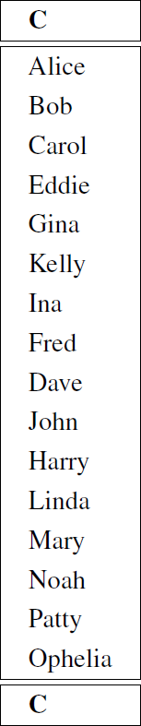
Sorting Algorithm | Invariant
Bubble Sort
Selection Sort
Quick Sort (with first element pivot) | All elements to the left/right of the pivot are smaller/larger

Slide 92
Sorting Algorithm | Invariant
Bubble Sort
Selection Sort
Quick Sort (with first element pivot) | All elements to the left/right of the pivot are smaller/larger
Since the ordering of elements in array C is different from the unsorted array, we know that at least one iteration of the sort was run. However, the largest element (Patty) is not at the end of the array. Thus, sorting algorithm C is not Bubble Sort.

Slide 93
Sorting Algorithm | Invariant
Bubble Sort
Selection Sort
Quick Sort (with first element pivot) | All elements to the left/right of the pivot are smaller/larger

Slide 94
Sorting Algorithm | Invariant
Bubble Sort
Selection Sort
Quick Sort (with first element pivot) | All elements to the left/right of the pivot are smaller/larger
The first 3 elements of array C are sorted, but not the 4th element. If sorting algorithm C is Selection Sort, it must have been run for no more than three iterations. Regardless of whether 1, 2, or 3 iterations were run, Mary should be in Alice’s original position in the array (due to swapping). However, this is not the case. Thus, sorting algorithm C is not Selection Sort.

Slide 95
Sorting Algorithm | Invariant
Bubble Sort
Selection Sort
Quick Sort (with first element pivot) | All elements to the left/right of the pivot are smaller/larger

Slide 96
Sorting Algorithm | Invariant
Bubble Sort
Selection Sort
Quick Sort (with first element pivot) | All elements to the left/right of the pivot are smaller/larger
Since the first element in the unsorted array (Mary) appears in its sorted location in array C and the elements to the left/right of Mary are smaller/larger, sorting algorithm C is possibly Quick Sort. However, we cannot say for sure as array F has the same properties! We can either try to execute Quick Sort step-by-step (not recommended), or try to figure out if array F’s identity can be determined to find out the identity of array C through elimination.

Slide 97
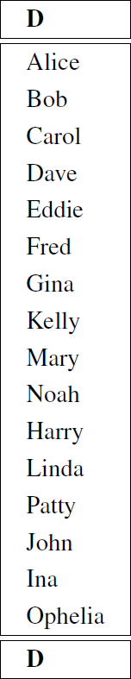
Sorting Algorithm | Invariant
Bubble Sort
Selection Sort
Quick Sort (with first element pivot) | All elements to the left/right of the pivot are smaller/larger

Slide 98
Sorting Algorithm | Invariant
Bubble Sort
Selection Sort
Quick Sort (with first element pivot) | All elements to the left/right of the pivot are smaller/larger

Slide 99
Sorting Algorithm | Invariant
Bubble Sort
Selection Sort
Quick Sort (with first element pivot) | All elements to the left/right of the pivot are smaller/larger
Since the ordering of elements in array D is different from the unsorted array, we know that at least one iteration of the sort was run. However, the largest element (Patty) is not at the end of the array. Thus, sorting algorithm D is not Bubble Sort.

Slide 100
Sorting Algorithm | Invariant
Bubble Sort
Selection Sort
Quick Sort (with first element pivot) | All elements to the left/right of the pivot are smaller/larger

Slide 101
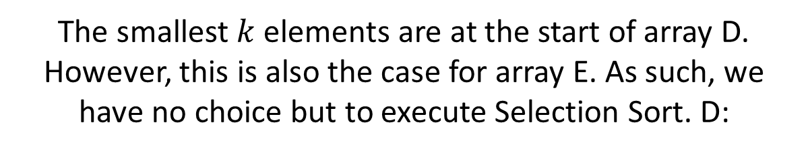
Sorting Algorithm | Invariant
Bubble Sort
Selection Sort
Quick Sort (with first element pivot) | All elements to the left/right of the pivot are smaller/larger

Slide 102
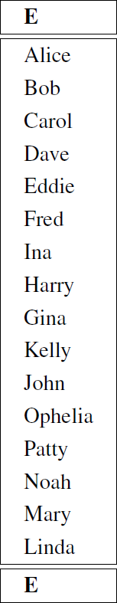
Selection sort
Select the minimum element
Add it to the sorted region of the array by swapping
Repeat until all elements have been selected

Slide 103
Selection sort
Select the minimum element
Add it to the sorted region of the array by swapping
Repeat until all elements have been selected

Slide 104
Selection sort
Select the minimum element
Add it to the sorted region of the array by swapping
Repeat until all elements have been selected

Slide 105
Selection sort
Select the minimum element
Add it to the sorted region of the array by swapping
Repeat until all elements have been selected
When executing Selection Sort, the position of Mary in array E is wrong. Thus, sorting algorithm D is Selection Sort!

Slide 106
Sorting Algorithm | Invariant
Bubble Sort
Quick Sort (with first element pivot) | All elements to the left/right of the pivot are smaller/larger

Slide 107
Sorting Algorithm | Invariant
Bubble Sort
Quick Sort (with first element pivot) | All elements to the left/right of the pivot are smaller/larger

Slide 108
Sorting Algorithm | Invariant
Bubble Sort
Quick Sort (with first element pivot) | All elements to the left/right of the pivot are smaller/larger
Since the ordering of elements in array E is different from the unsorted array, we know that at least one iteration of the sort was run. However, the largest element (Patty) is not at the end of the array. Thus, sorting algorithm E is not Bubble Sort.

Slide 109
Sorting Algorithm | Invariant
Bubble Sort
Quick Sort (with first element pivot) | All elements to the left/right of the pivot are smaller/larger

Slide 110
Sorting Algorithm | Invariant
Bubble Sort
Quick Sort (with first element pivot) | All elements to the left/right of the pivot are smaller/larger
Since the position of the pivot element Mary is incorrect, sorting algorithm E cannot be Quick Sort.

Slide 111
Sorting Algorithm | Invariant
Bubble Sort
Quick Sort (with first element pivot) | All elements to the left/right of the pivot are smaller/larger
By elimination, sorting algorithm E is none of the 5 sorting algorithms!

Slide 112
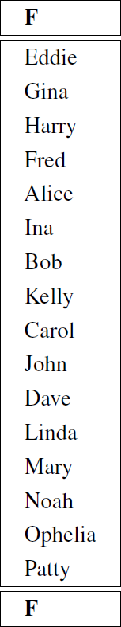
Sorting Algorithm | Invariant
Bubble Sort
Quick Sort (with first element pivot) | All elements to the left/right of the pivot are smaller/larger

Slide 113
Sorting Algorithm | Invariant
Bubble Sort
Quick Sort (with first element pivot) | All elements to the left/right of the pivot are smaller/larger

Slide 114
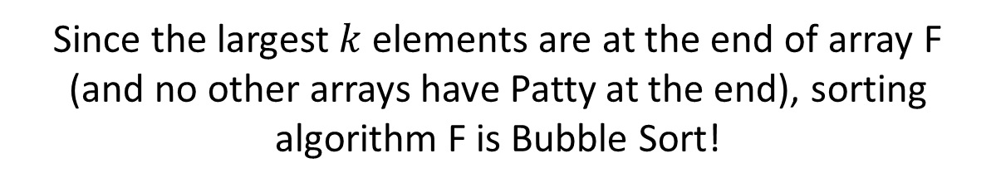
Sorting Algorithm | Invariant
Bubble Sort
Quick Sort (with first element pivot) | All elements to the left/right of the pivot are smaller/larger

Slide 115
Sorting Algorithm | Invariant
Quick Sort (with first element pivot) | All elements to the left/right of the pivot are smaller/larger
By the process of elimination, sorting algorithm C is Quick Sort!

Slide 116
ALGORITHM ANALYSIS (CS2040S 2020 MIDTERM)

Slide 117
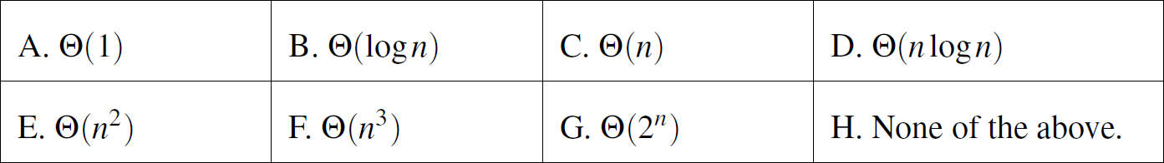
Algorithm Analysis
For each of the following, choose the best (tightest) asymptotic function from among the given options. Some of the following may appear more than once, and some may appear not at all. Write the letter indicating the proper bound in the answer box.

Slide 118
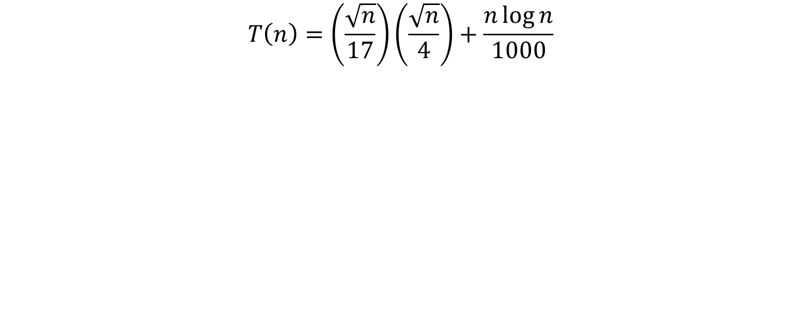
Algorithm Analysis

Slide 119
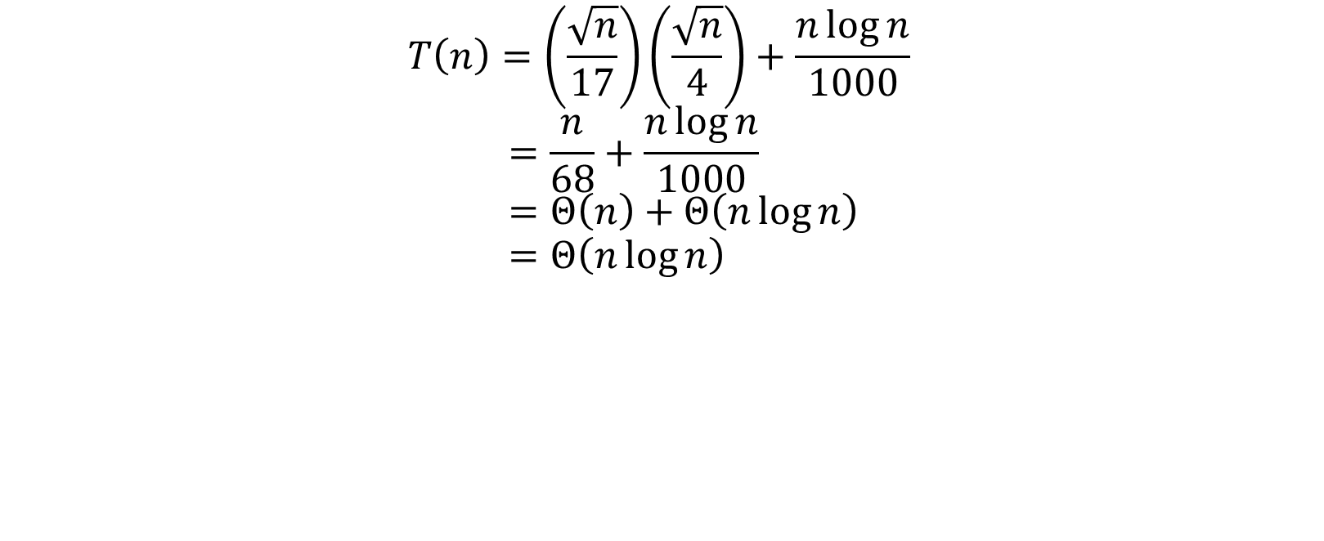
Algorithm Analysis

Slide 120
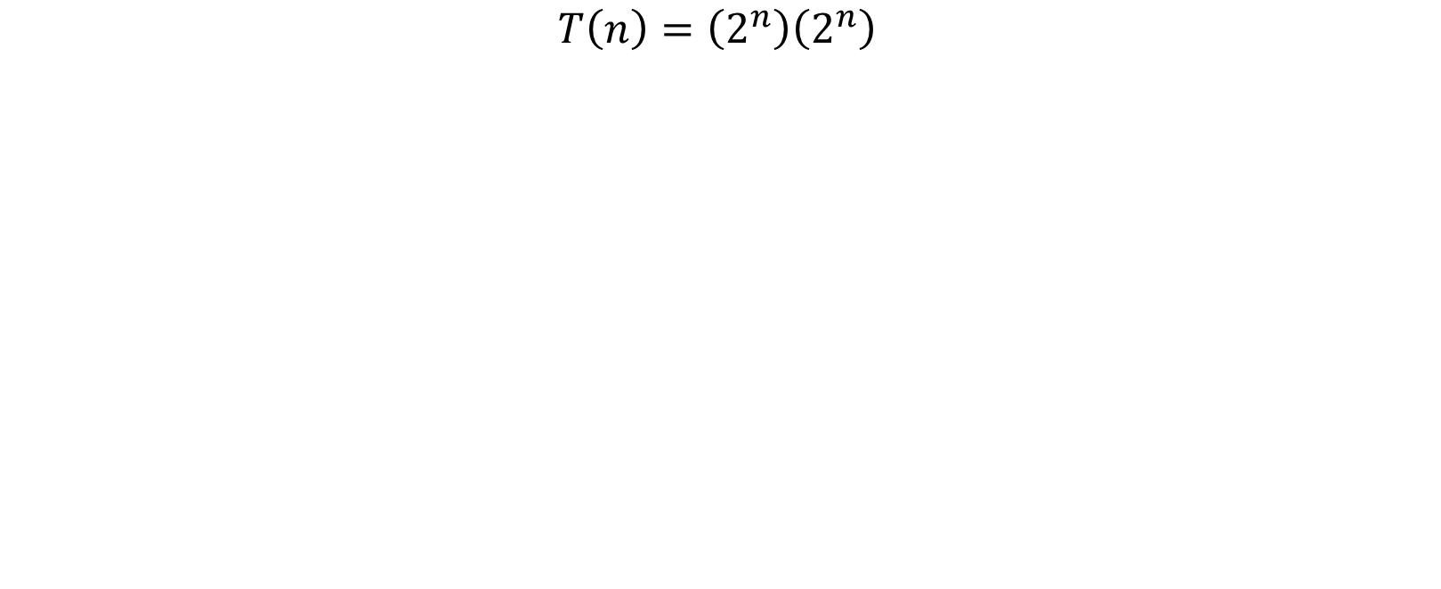
Algorithm Analysis

Slide 121
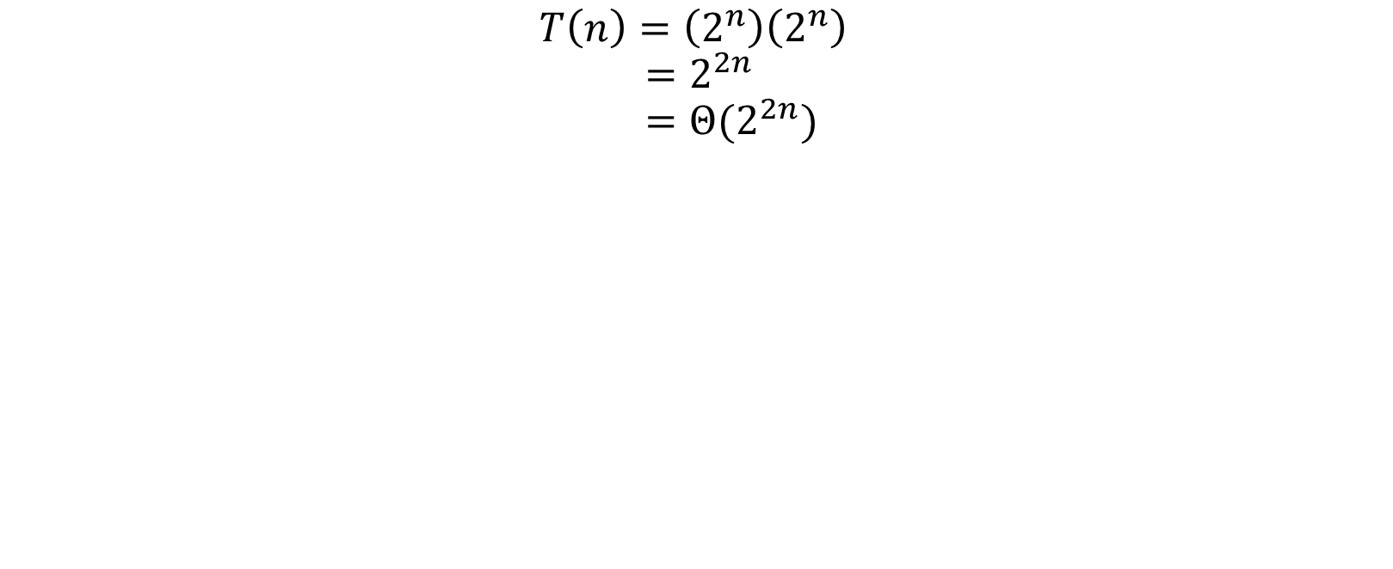
Algorithm Analysis

Slide 122
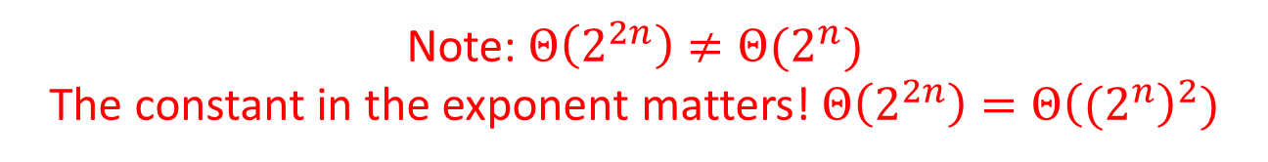
Algorithm Analysis

Slide 123
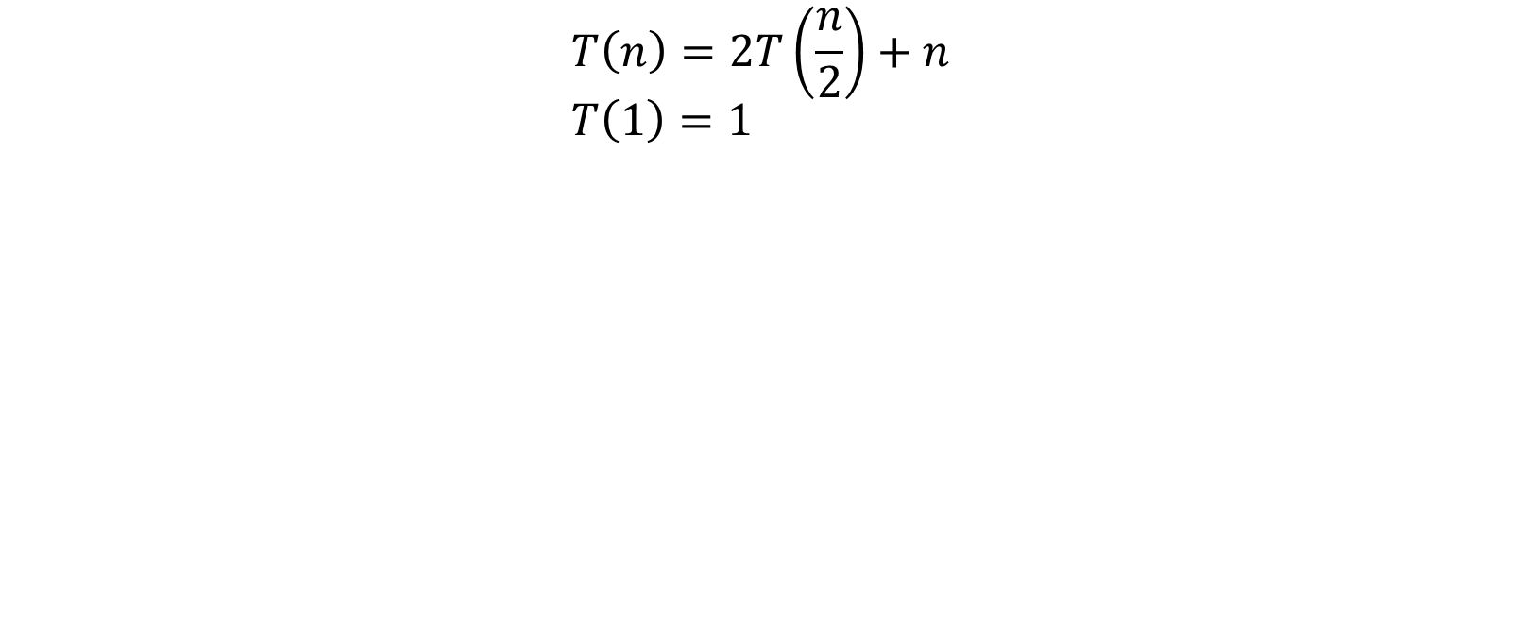
Algorithm Analysis

Slide 124
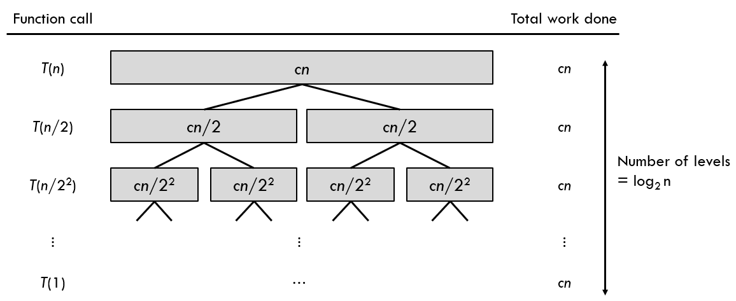
Algorithm Analysis

Slide 125
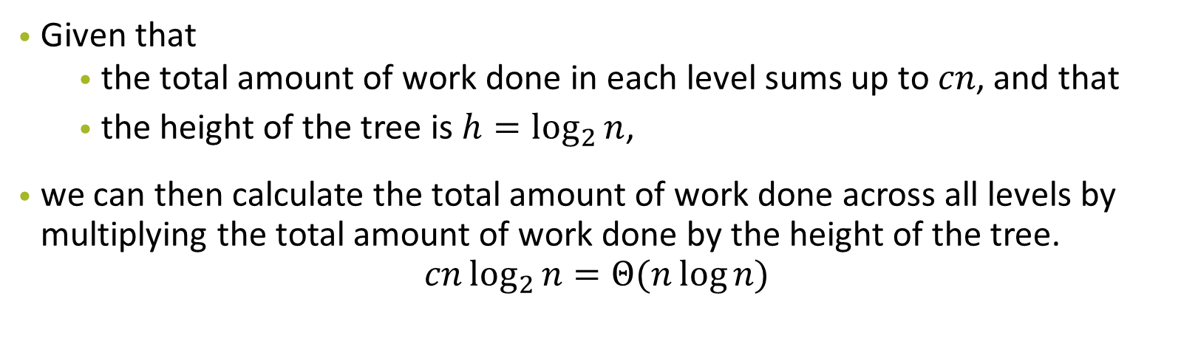
Algorithm Analysis

Slide 126
Algorithm Analysis
public static int loopy(int n) { for (int i = 0; i < n; i++) { for (int j = 0; j < i; j++) { System.out.println(“Hello.”); } } }

Slide 127
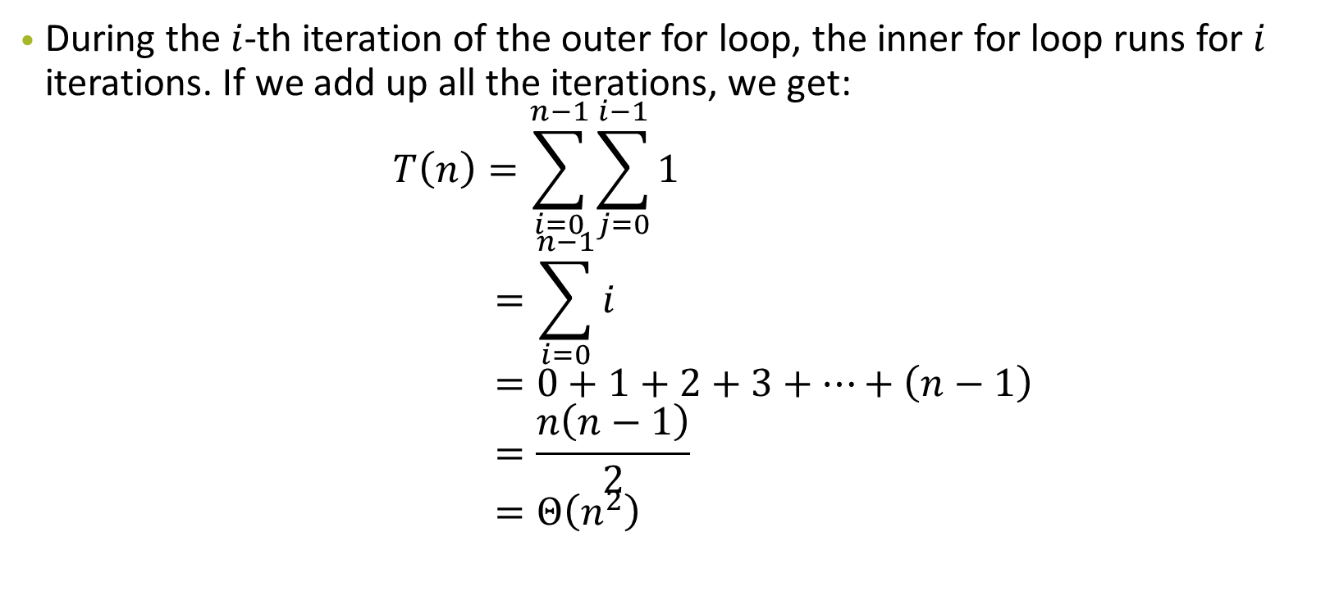
Algorithm Analysis

Slide 128
Algorithm Analysis
public static int recursiveloopy(int n) { for (int i = 0; i < n; i++) { for (int j = 0; j < n; j++) { System.out.println(“Hello.”); } } if (n <= 2) { return 1; } else if (n % 2 == 0) { return recursiveloopy(n + 1); } else { return recursiveloopy(n – 2); } }

Slide 129
Algorithm Analysis
for (int i = 0; i < n; i++) { for (int j = 0; j < n; j++) { System.out.println(“Hello.”); } }

Slide 130
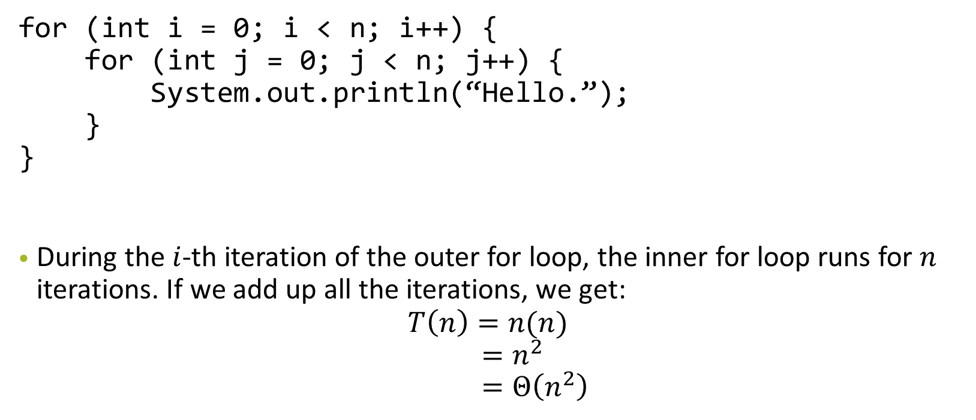
Algorithm Analysis

Slide 131
Algorithm Analysis
if (n <= 2) { return 1; } else if (n % 2 == 0) { return recursiveloopy(n + 1); } else { return recursiveloopy(n – 2); }

Slide 132
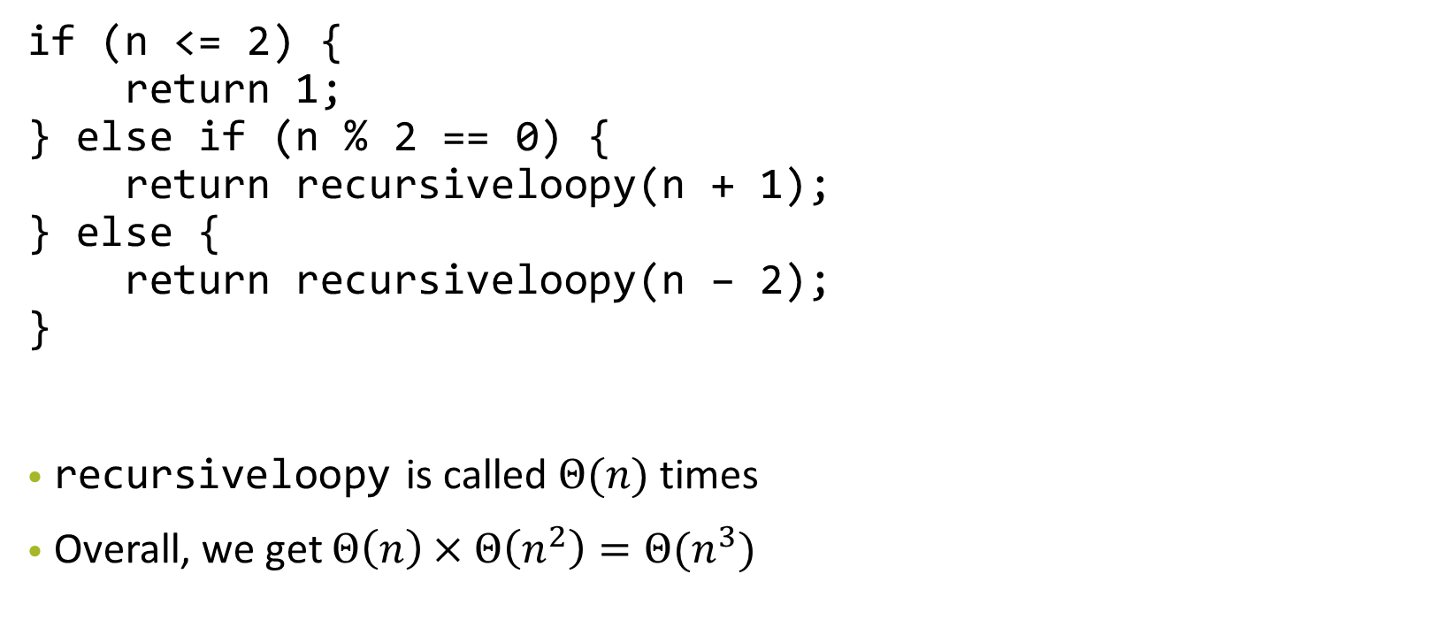
Algorithm Analysis

Slide 133
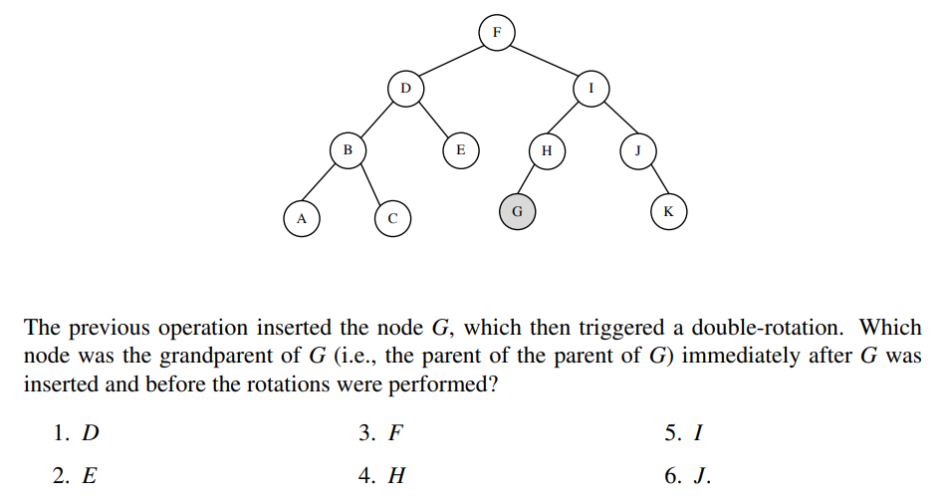

Slide 134
2021 5D
Okay, so G made the right subtree of the grandparent left heavy
(great grandparent of G is F → F is parent of G)
F
D
I
B
E
H
J
A
C
G
K

Slide 135
2021 5D
Okay, so G made the right subtree of the grandparent left heavy
-> some shape like this?
-> via a right rotate and a left rotate.
Let’s just try to get this shape by picking a random place to reverse-left rotate and then reverse-right rotate
h=4
h=3
h=1
h=1
h=2
h=0
h=1
G

Slide 136
2021 5D
F
work backwards: the right left rotate means you rotate left then right
h=5
h=1
h=4
D
I
B
E
H
J
A
C
G
K
G

Slide 137
2021 5D
h=5
work backwards: the right left rotate means you rotate left then right
h=4
h=1
h=4
h=3
h=1
h=1
h=2
h=0
h=1
G
G

Slide 138
MIDTERM SORTING (CS2040S 2021 MIDTERM)

Slide 139
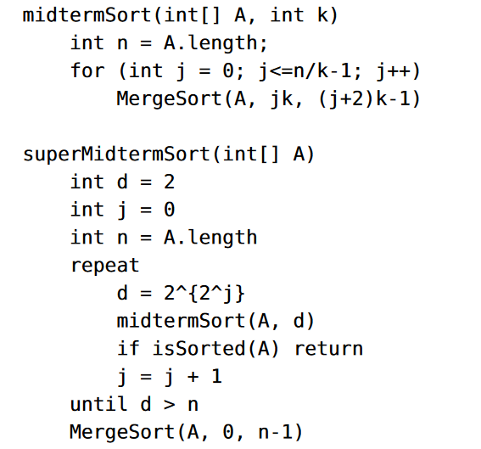
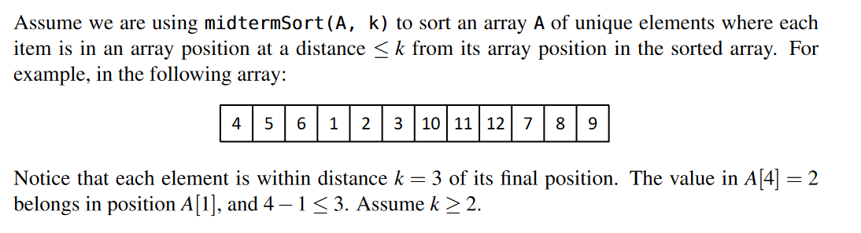

Slide 140
midterm sort idea: splits the array into chunks of k elements
In each loop, sort two of the chunks.
since the items are at most k distance away from their true position (ie worst case they are in the previous chunk or the next chunk), after sorting each section twice (with the previous chunk, and the next chunk) they will get into the right place

Slide 141
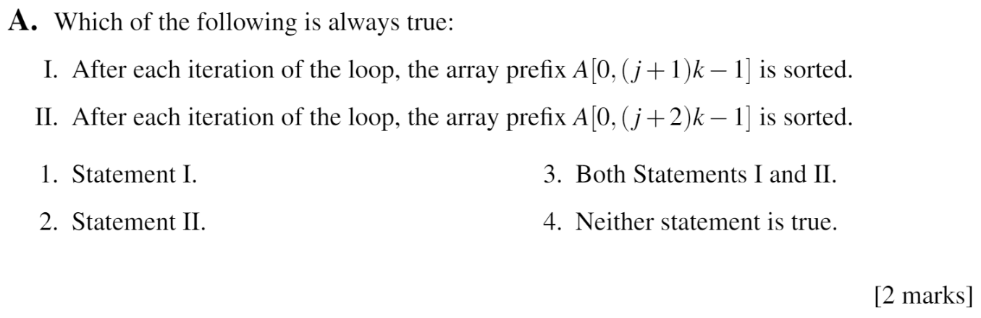
Midterm Sorting

Slide 142
Midterm Sorting

Slide 143
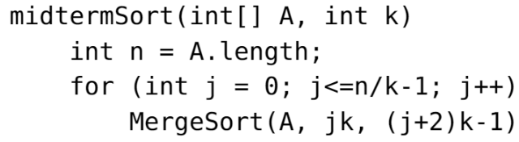
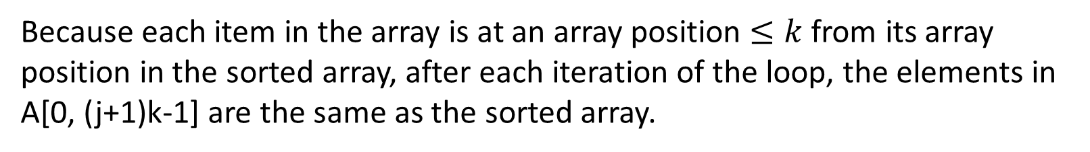
Midterm Sorting

Slide 144
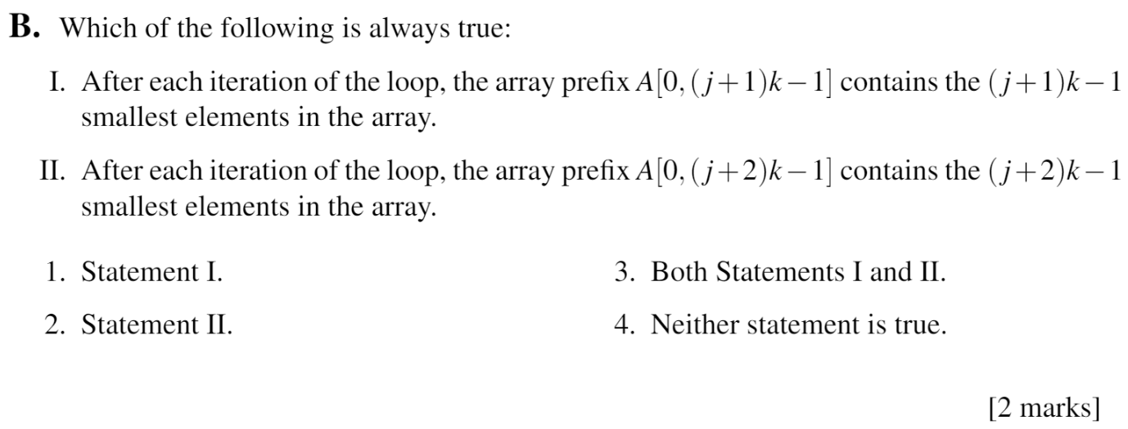
Midterm Sorting

Slide 145
Midterm Sorting

Slide 146
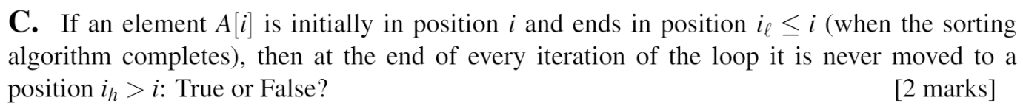
Midterm Sorting

Slide 147
Midterm Sorting

Slide 148
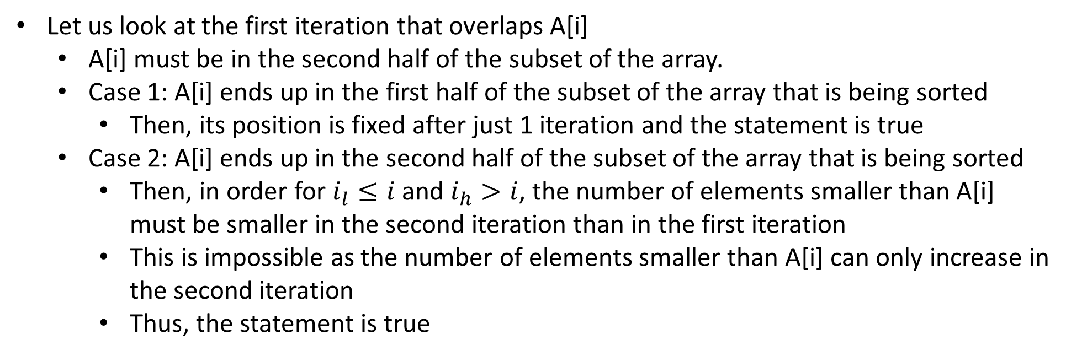
Midterm Sorting

Slide 149
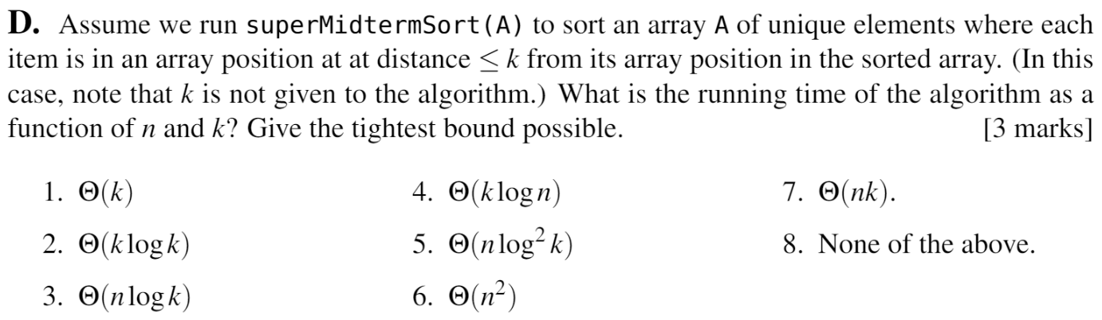
Midterm Sorting

Slide 150
Midterm Sorting

Slide 151
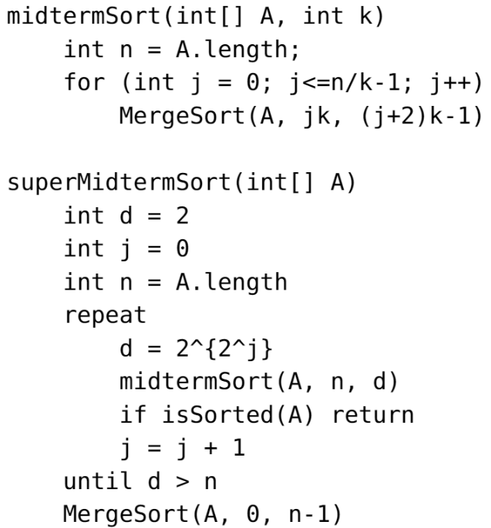
Midterm Sorting

Slide 152
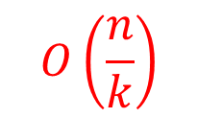
Midterm Sorting

Slide 153
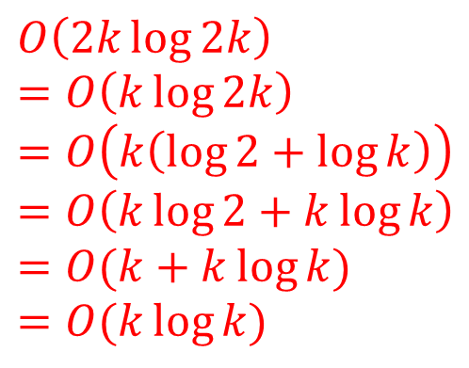
Midterm Sorting

Slide 154
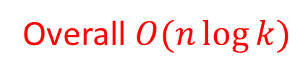
Midterm Sorting

Slide 155
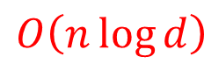
Midterm Sorting

Slide 156
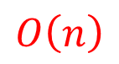
Midterm Sorting

Slide 157
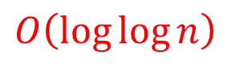
Midterm Sorting

Slide 158
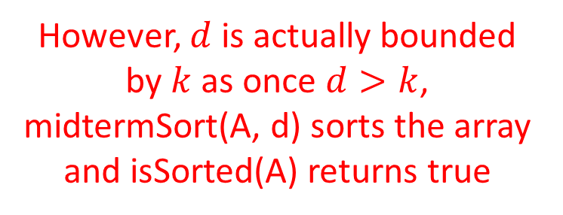
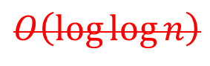
Midterm Sorting

Slide 159
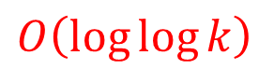
Midterm Sorting

Slide 160

Midterm Sorting

Slide 161
Midterm Sorting

Slide 162
Midterm Sorting
True, because merge sort is stable

Slide 163
Midterm Sorting

Slide 164
Midterm Sorting
False, because merge sort (as defined in class) is not in-place

Slide 165

Midterm Sorting

Slide 166
Midterm Sorting

Slide 167
Midterm Sorting

Slide 168
Midterm Sorting

Slide 169

Midterm Sorting

Slide 170

Midterm Sorting

Slide 171

Midterm Sorting

Slide 172

Midterm Sorting

Slide 173

Notes:
Credits to Jeanne for the slides

Slide 174

Notes:
Credits to Jeanne for the slides

Slide 175

Notes:
Credits to Jeanne for the slides

Slide 176

Notes:
Credits to Jeanne for the slides

Slide 177

Notes:
Credits to Jeanne for the slides

Slide 178

Notes:
Credits to Jeanne for the slides

Slide 179

Notes:
Credits to Jeanne for the slides

Slide 180

Notes:
Credits to Jeanne for the slides

Slide 181

2017 q2c
read carefully!

Slide 182
it’s a trick question : (
n is divided into n/10 equal sized parts → parts of size 10
Since cost is O(1) when less than size 20, work per part = O(1)
n/10 parts → O(n)

Slide 183

2020 3c
how do they work?

Slide 184
2020 3c
𝚹(log(n/m))
= 𝚹(logn - logm)
n items in the sorted array
x appears m times
every time it loops, it searches half the array again. because it’s sorted, the more elements in m the earlier the loop will terminate. it’s -log(m) because that’s how many loops early it will terminate

Slide 185

2021 5D
strategy: work backwards/ guess and check
double rotation means that zig-zag shape
G is in the left tree of H

Slide 186


zig zag shape!
(T1, T2, etc are subtrees)
(inserted node is somewhere in the leaves, ofc)
Can deduce v.right must be left heavy (v is grandparent) (Right Left case)
https://www.geeksforgeeks.org/avl-tree-set-1-insertion/

Slide 187
actually, you can just infer the answer from this via pattern recognition.
The parent of the newly inserted node becomes the root of the balanced subtree
https://www.geeksforgeeks.org/avl-tree-set-1-insertion/

Slide 188
D
B
E
J
G
A
C
K

